Slide 1
WELCOME

Slide 2
E-PURCHASE REQUISITION SYSTEM
PRESENTED BY :
SUBHARANGSHU CHAUDHURI
SUBHAJIT GANGULY
SUBHRO DUTTA
VIKASH SINGH
SUKANTA SHARMA

Slide 3
:INTRODUCTION:
What is e-purchase requisition system in our project?
Basically E-Purchasing Requisition System is use of the Internet for our day to day needs. E-purchasing mainly extends to Online-Shopping of the different amenities required in our life. Online shopping is of massive help in this country where we can sit in our homes and order different stuff through the internet, and then within a couple of days the order will reach your destination.

Slide 4
ADVANTAGES OF OUR PROJECT
Our project or site can provide the interface to buy with the add-ons which are not available on any physical stores.
Many people browse through popular ecommerce stores and search engines to find whatever they are looking for. While there are some disadvantages to buying products online, there are many more advantages and benefits. These are the top five reasons to shop online.
1. Better Prices
2. Convenience
3. Variety

Slide 5
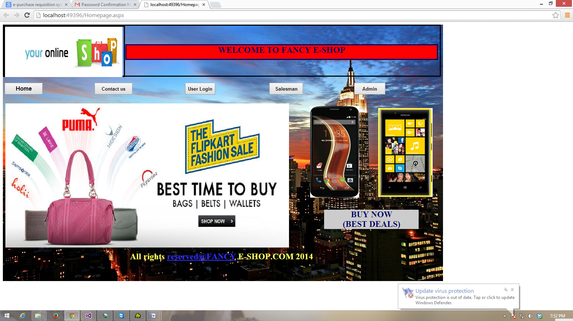
HOME PAGE

Slide 6
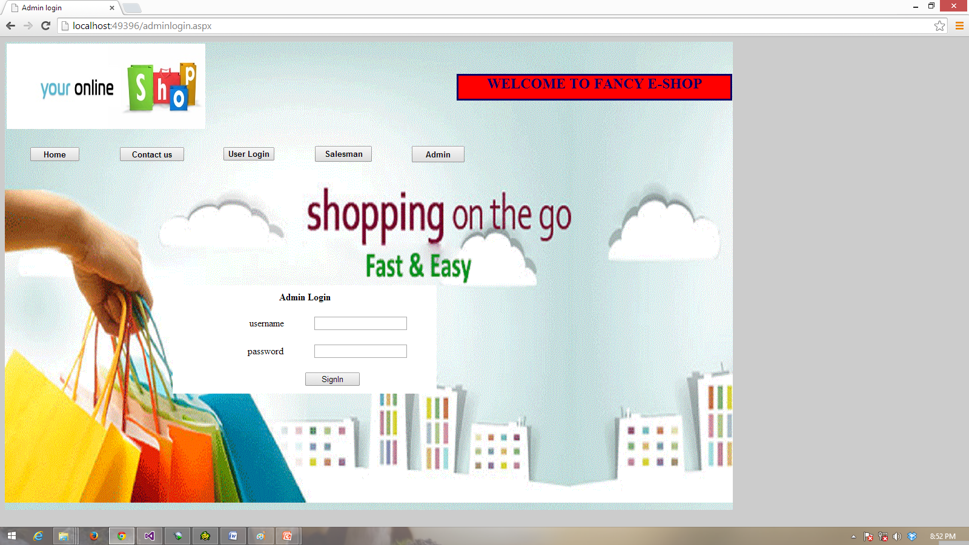
:ADMIN LOGIN:

Slide 7
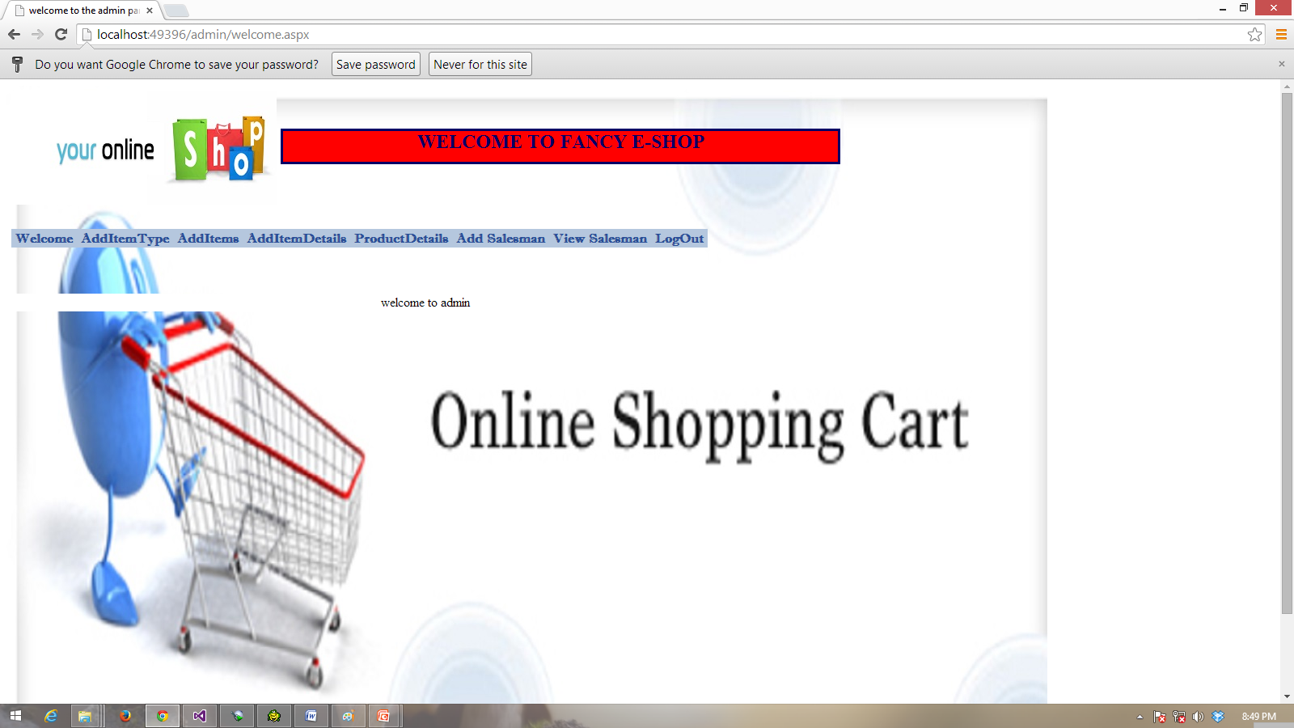
:ADMIN FUNCTIONS:

Slide 8
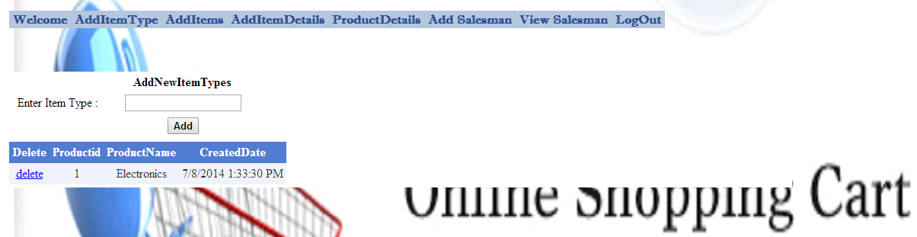
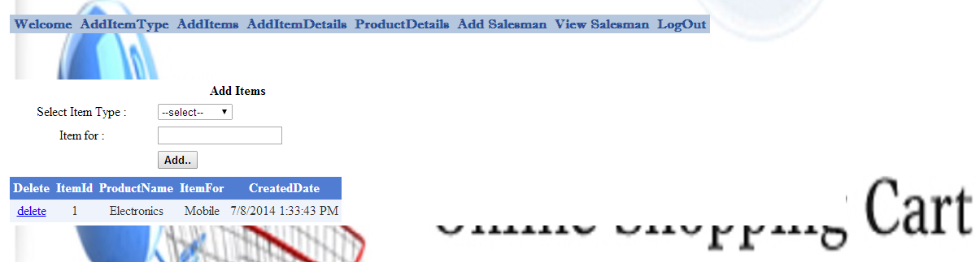
ADD NEW ITEM TYPES & ADD ITEMS

Slide 9
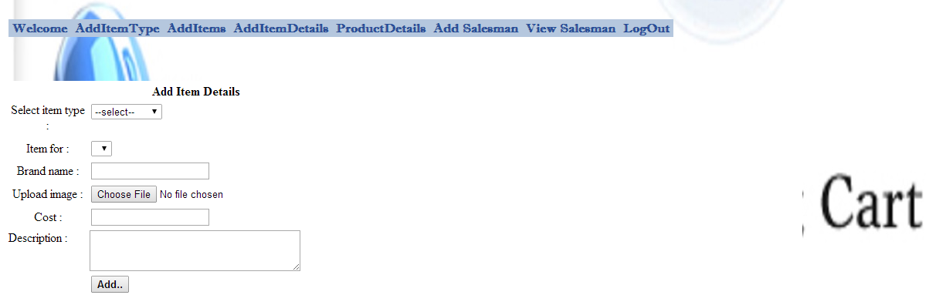
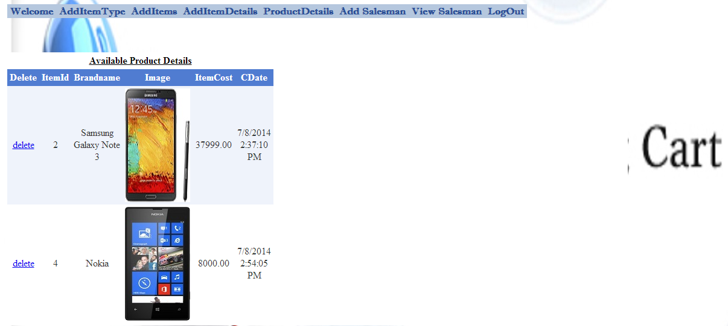
ADD ITEM DETAILS & AVAILABLE PRODUCT DETAILS

Slide 10
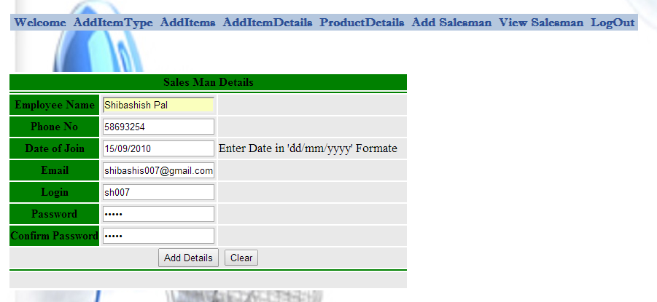
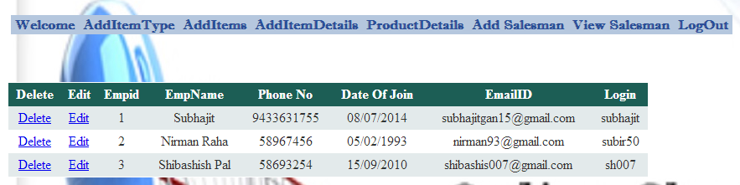
ADD SALESMAN & VIEW SALESMAN

Slide 11
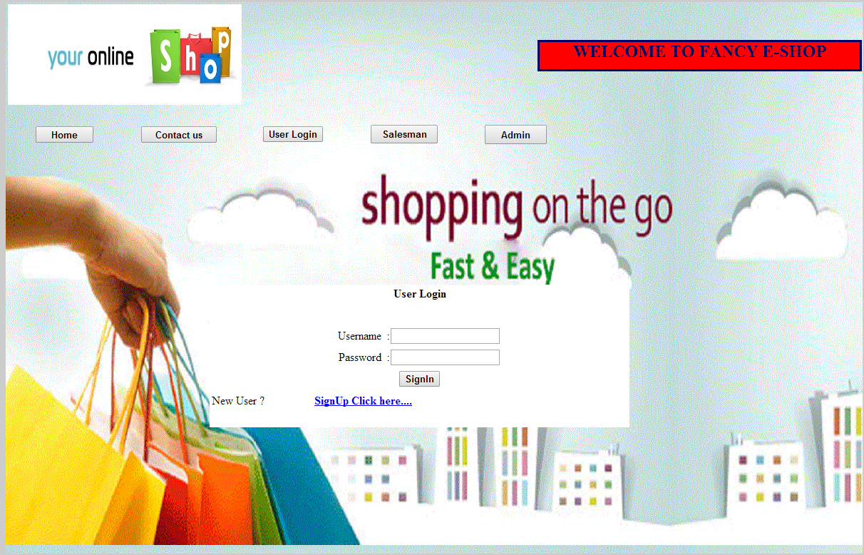
:USER LOGIN:

Slide 12
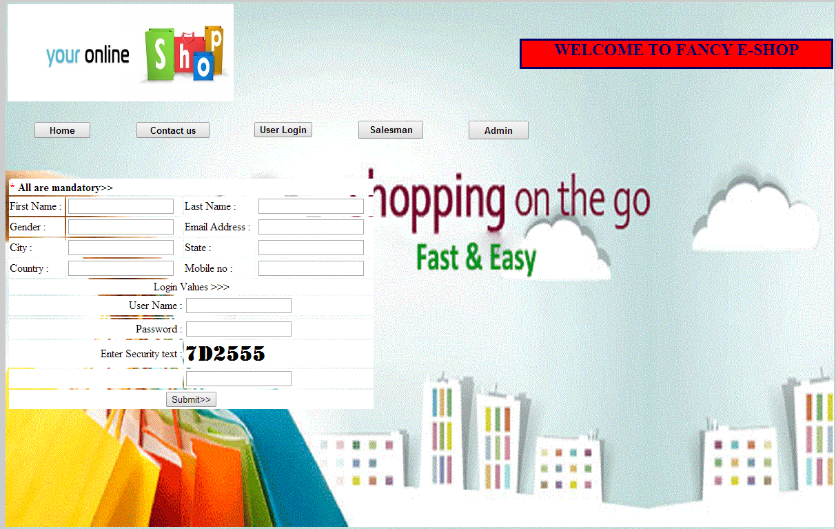
NEW USER SIGNUP

Slide 13
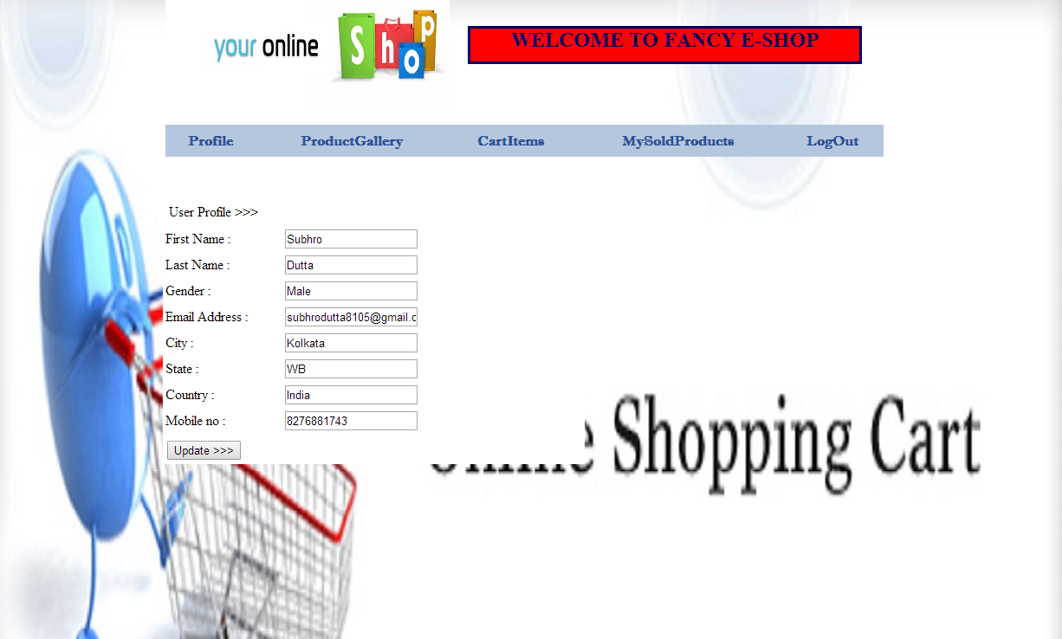
USER DETAILS & FUNCTIONS

Slide 14
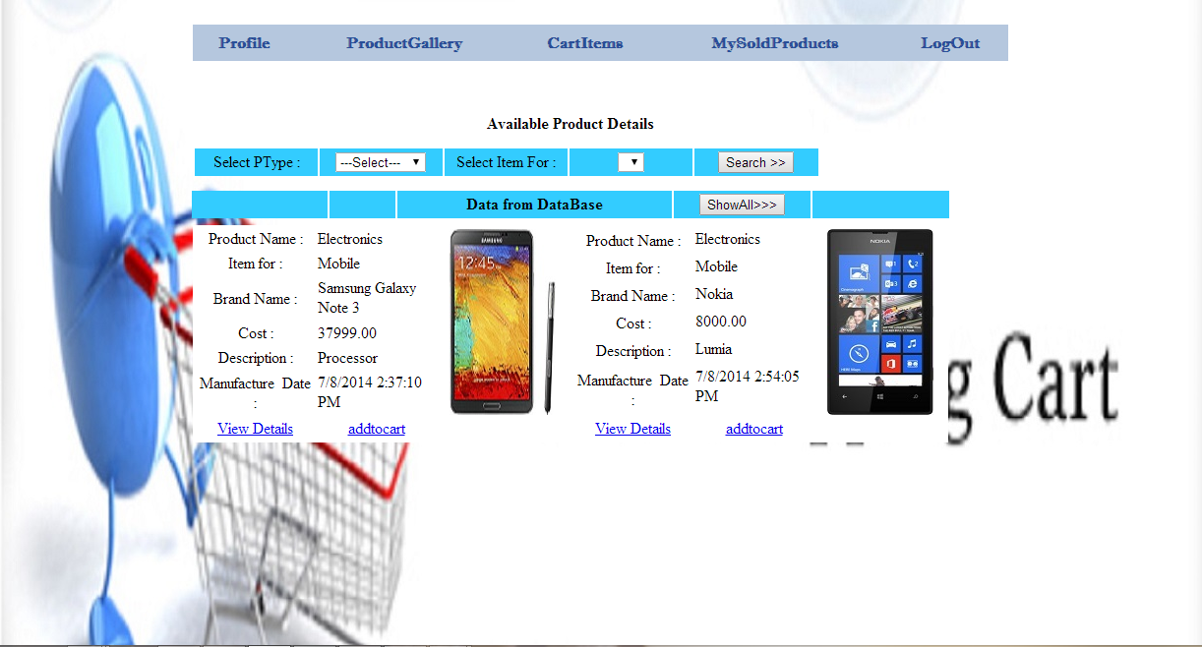
PRODUCT DETAILS

Slide 15
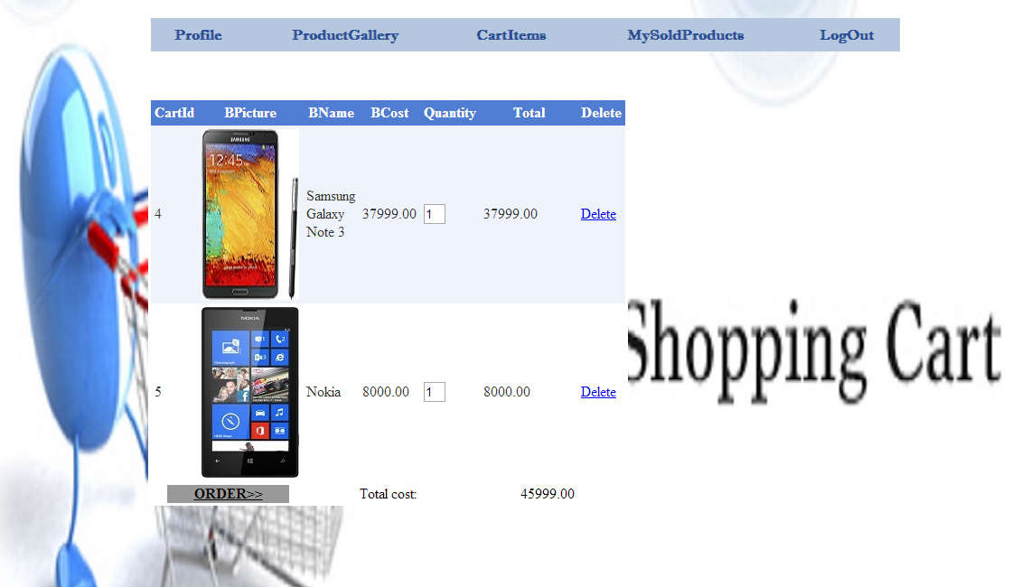
CART ITEMS

Slide 16
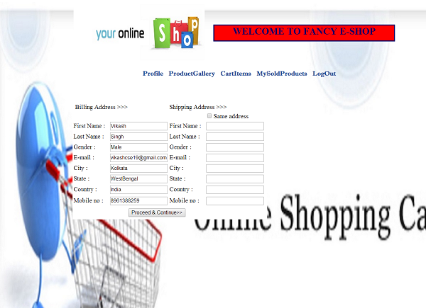
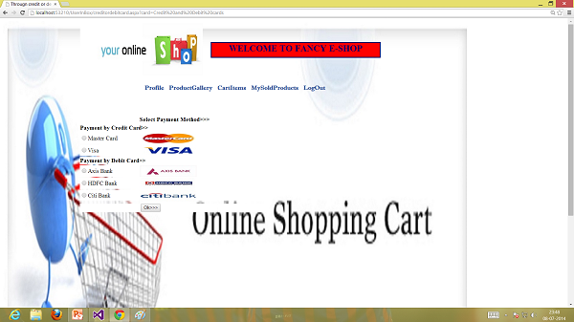
SHIPPING ADDRESS AND PAYMENT

Slide 17
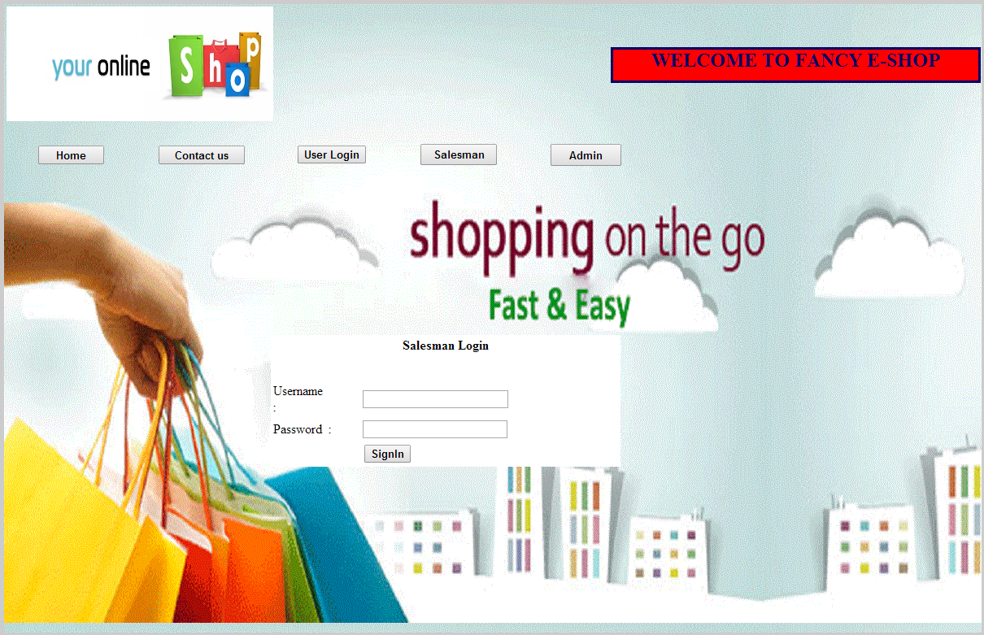
SALESMAN LOGIN

Slide 18
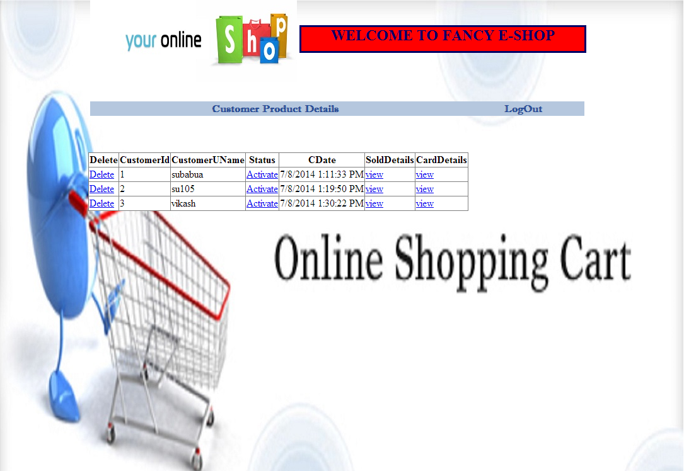
CUSTOMER PRODUCT DETAILS

Slide 19
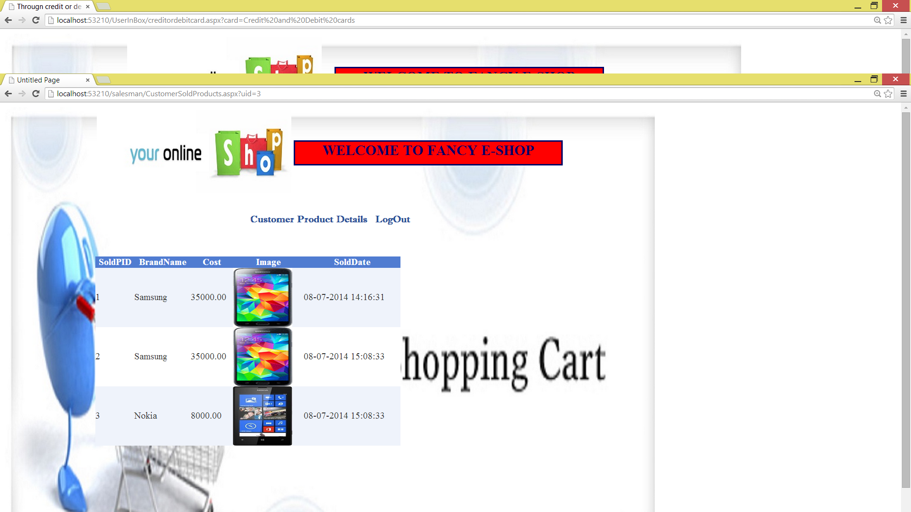
SALESMAN SOLD ITEMS DETAILS

Slide 20
:CONCLUSION:
The project “E-Purchasing Requisition” is something like the original grocery shop shopping cart that is used by the customer in selecting certain products. Finally after selection the customer confirms orders for all the purchasing items and submits his/her account details with tax information at the checkout counter.
Shopping cart software is its security as better security can attract customer by protecting their personal information. Security features include encrypting information and using a reputable processing service for credit cards.
Using certain add-ons like that of the PayPal system in the future will further enhance the reputation of the website.

Slide 21
THANK YOU

